Slide 1

Connect Four Game
Nabeel Thoppil Navas (221ADB019)
Sriram Raghu Kumar (221ADB037)
Puneet Sethi (221ADB032)

Slide 2

: What You Need to Know
Project Description
Impact of Extension
Requirements
Testing Strategies
Design Options and Decisions
Lessons Learned

Slide 3
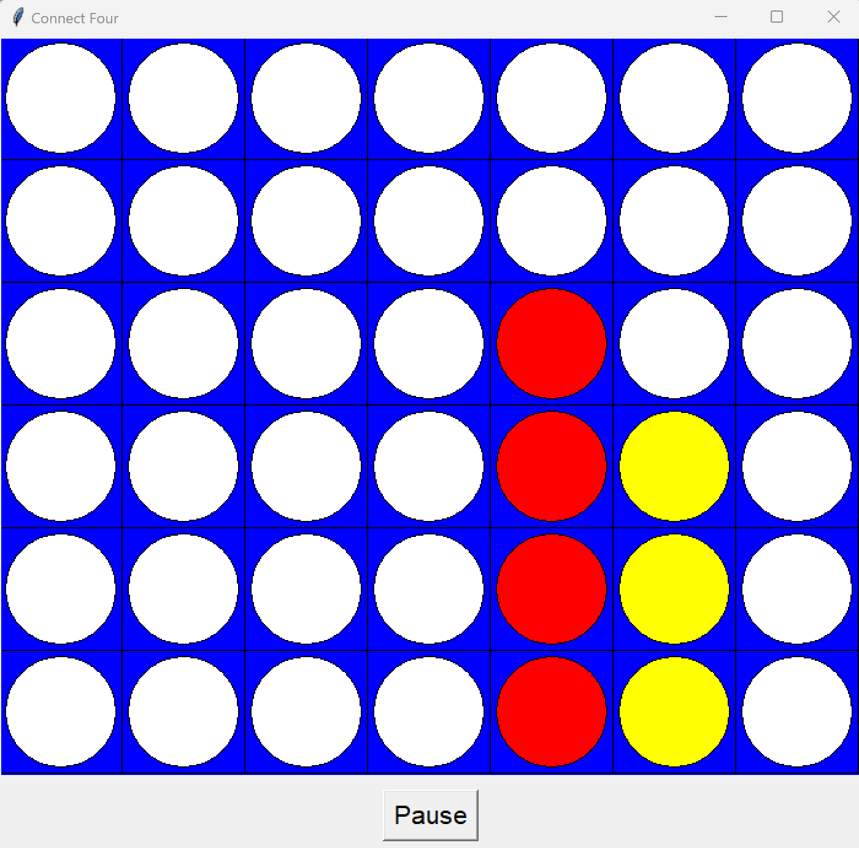
Connect Four
We developed a classic Connect Four game using Python and the Tkinter library.
Objective: Players take turns dropping colored discs into a grid. The goal is to connect four of one's own discs in a row, column, or diagonal before the opponent.

Slide 4
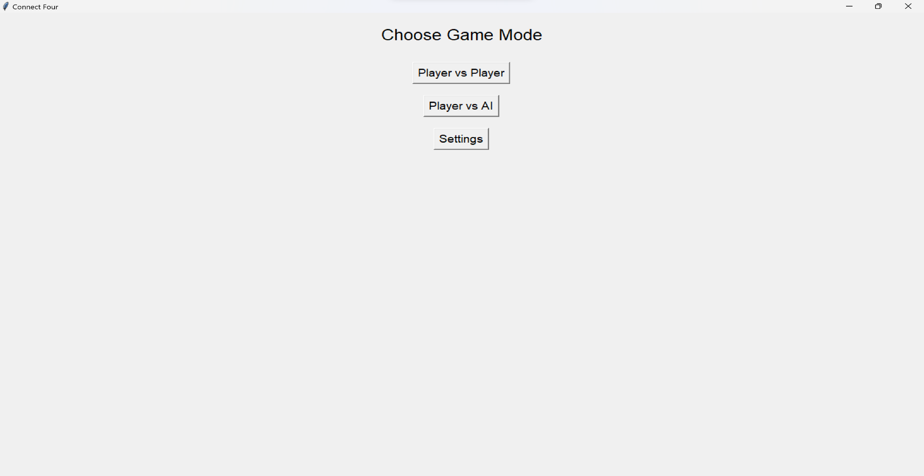
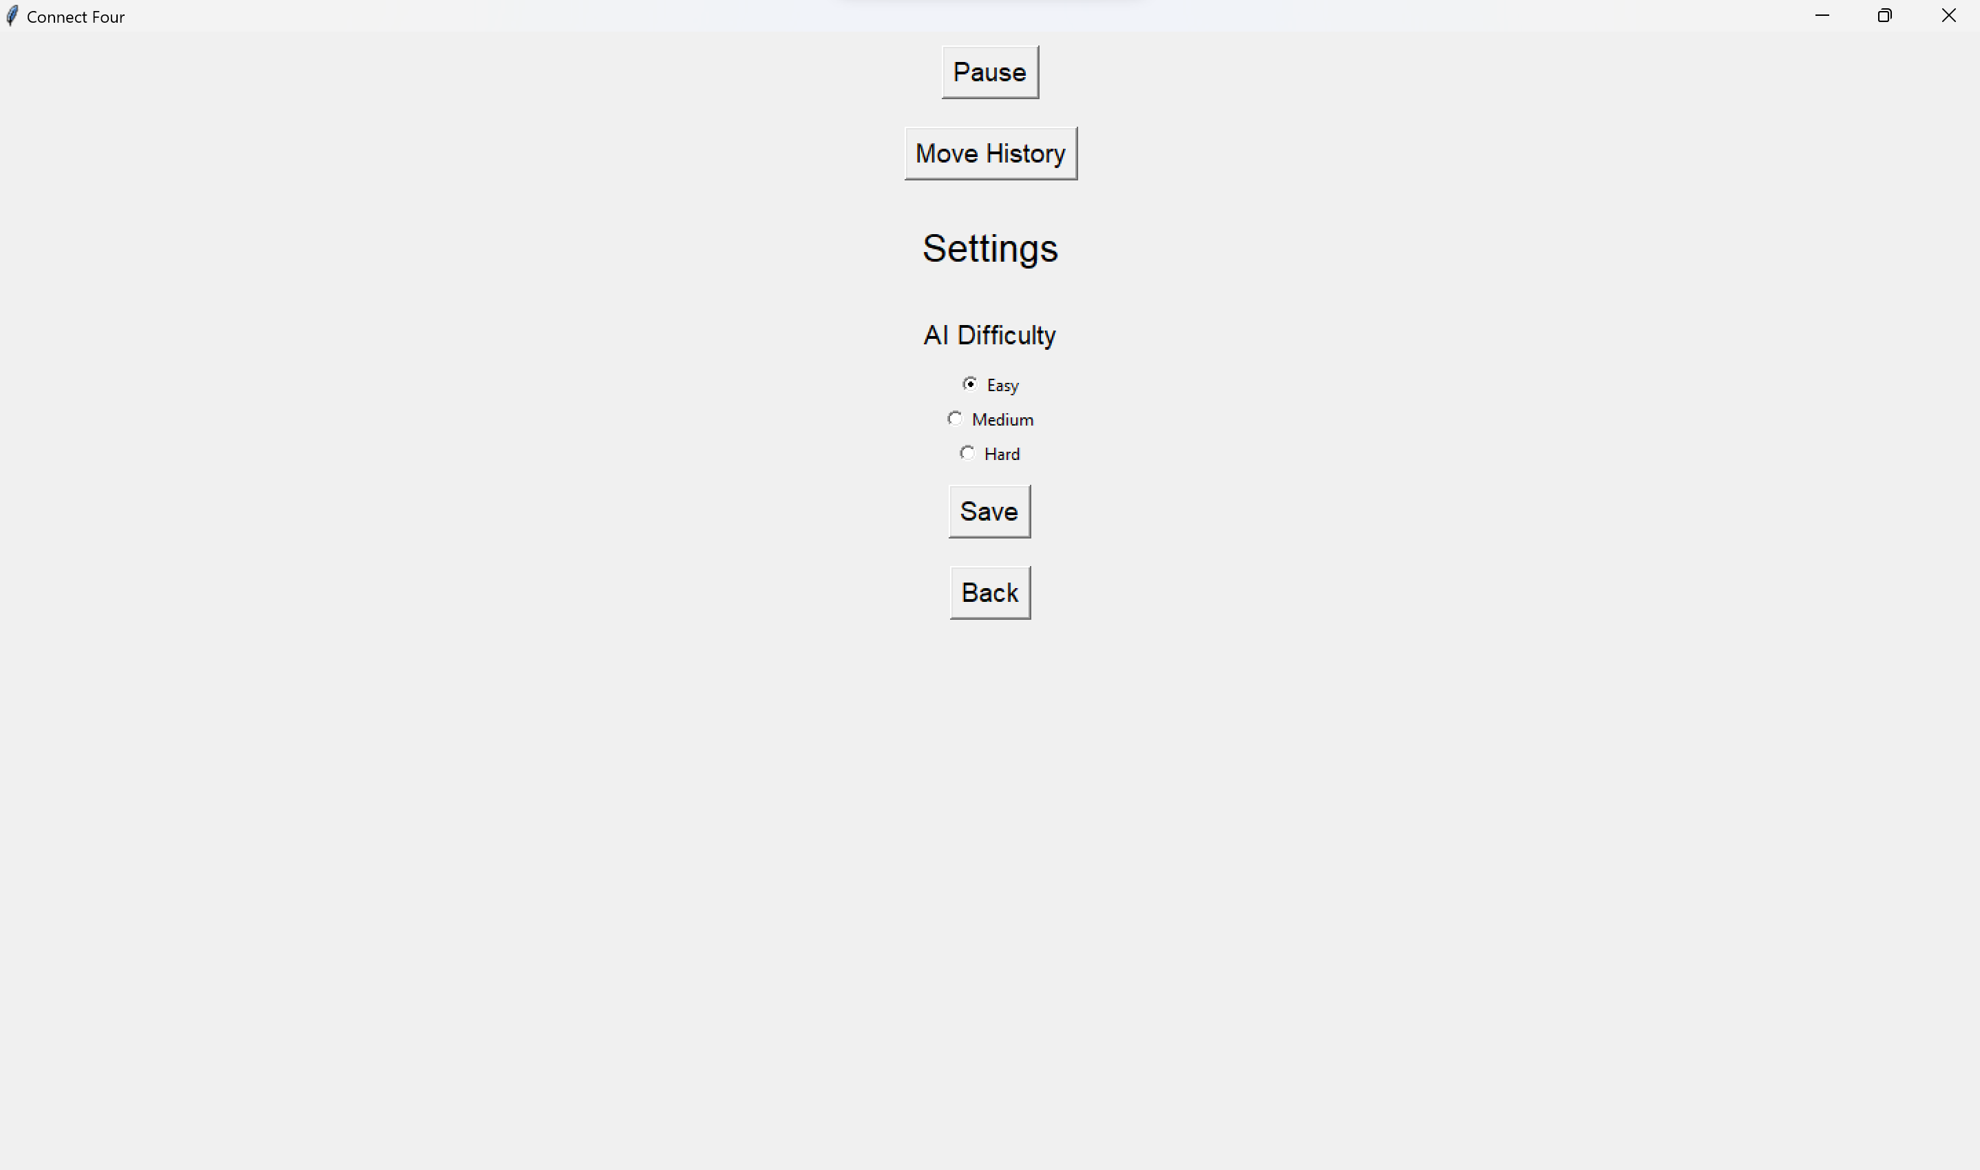
Requirements
Game Modes: Two-player mode and Player vs. AI mode
AI Difficulty: Players can adjust the AI difficulty level.
Additional Features: Game pausing and resuming, move history display.

Slide 5

Design Options and Decisions
Design 1 | Design 2
Connect Four Class: All in One Class Handles UI and Logic. 2. Board Class: Organized Structure Separate Board Logic | Connect Four Class: Simplified Design Organized Structure 2. Player Class Player info encapsulation Enhances Flexibility

Slide 6

Impact of Extension
A.I
Design Influence: AI addition required seamless integration with the game logic.
AI Difficulty Levels: Developed multiple levels to adjust to different player skills.
Balancing Challenge: Ensured AI is challenging but fair to provide an enjoyable experience.

Slide 7

Testing Strategies
Game Logic: Verified the correctness of player moves and win conditions.
State Transitions: Tested pausing and resuming functionalities.
AI Behavior: Ensured AI responses were logical and varied by difficulty.
Equivalence Classes: Included tests for valid/invalid moves, column full, player vs player, player vs AI, move history, draw condition and exit game.

Slide 8
Lessons Learned:
Programming Concepts
Software process
Team Collaboration
Enhanced understanding of GUI programming, object-oriented design, and AI algorithms.
Appreciated the value of iterative development and comprehensive testing.
Recognized the importance of clear communication and teamwork.

Slide 9

Thank You

